Slide 1
CatanDice Demo

Slide 2
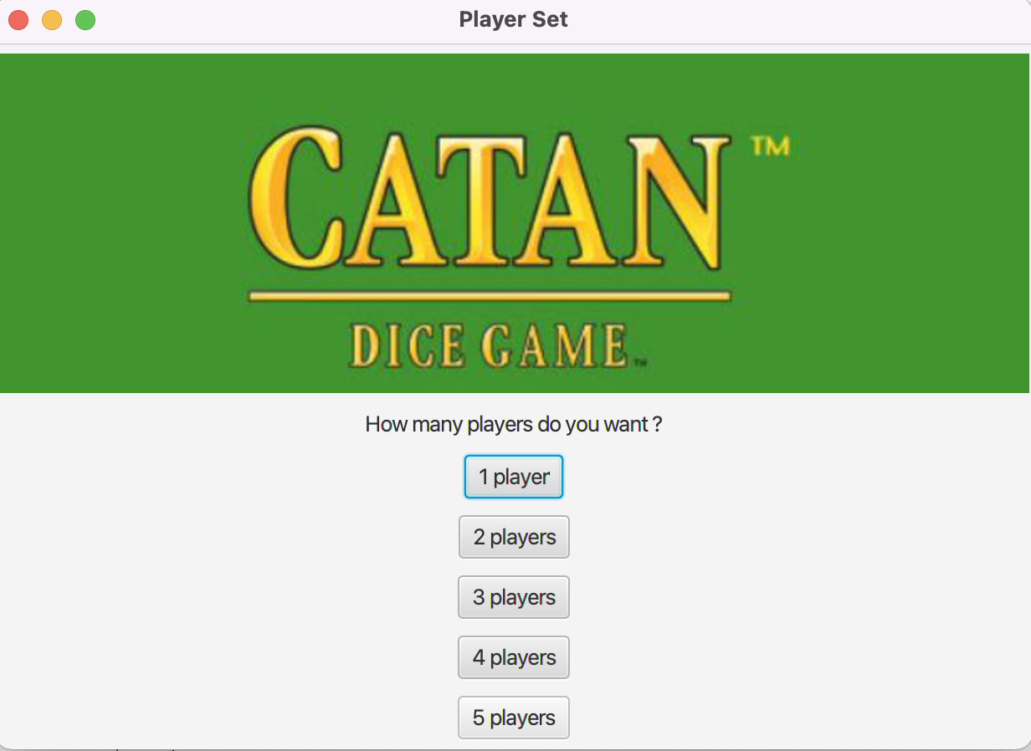
Step 1: Choose the Number of Players
In this step you can choose how many people will play the game. At this step you can choose how many individuals will participate in the game. Up to five people can participate in the game.
Here we choose two players for demonstration.

Slide 3
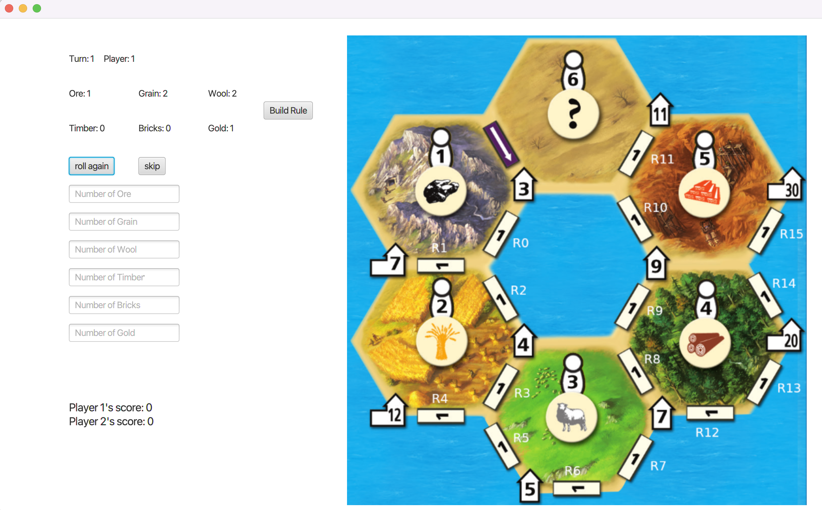
Step 2: Roll Dice
For player 1:
At the beginning of each round, the game will automatically update the first resource for you. Then you have two options:
You can reroll the dice with resources you don't want to see if you can get the resources you need.
You can also push skip button to skip this step if you are satisfied with your current resource state.
Repeat this step since you still have a chance to reroll the resources.

Slide 4
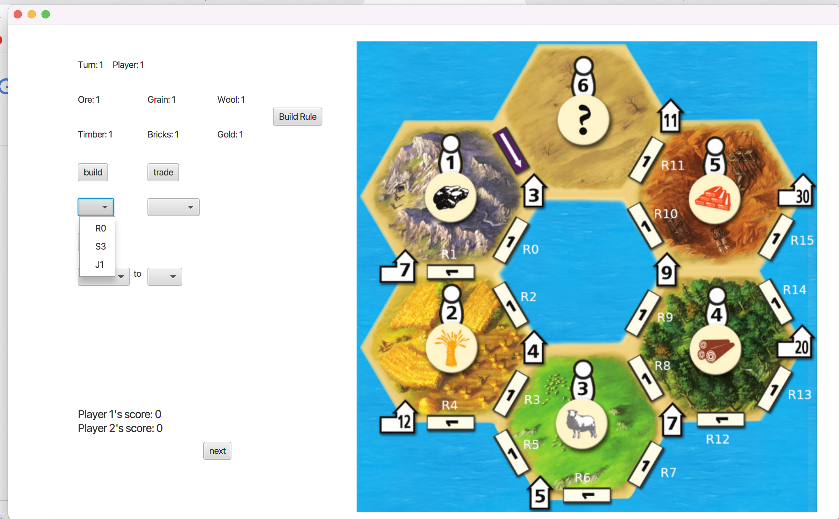

Step 3: Build Constructions
For Player 1
In the drop down menu under build button, you can choose the construction you want build. The drop down menu will automatically provide constructions you can build based on current resources and building constraint.
For example, in this step, we can choose R0. To build R0, we need to push build button. We also build J1 after we build R0 similarly.
The second picture is the result. When the constructions are built, the score will be updated automatically.

Slide 5


Step 3: Build Constructions
There may be some cases resources is not enough for players to build constructions, so we need to trade or swap.
Similar to build, the drop down menu under swap button will automatically provide chooses for you to select recourses you want used for swap and anther drop down menu will also automatically provide chooses for you to select recourses you can swap for. For example, in this step, we only swap for ore.
Push swap button, you can do swap action. The result is like the second picture. If you do not want to perform any other actions, you can click next button and then player 2 can roll dices and build constructions in turn 1 following step 2 and step 3.

Slide 6
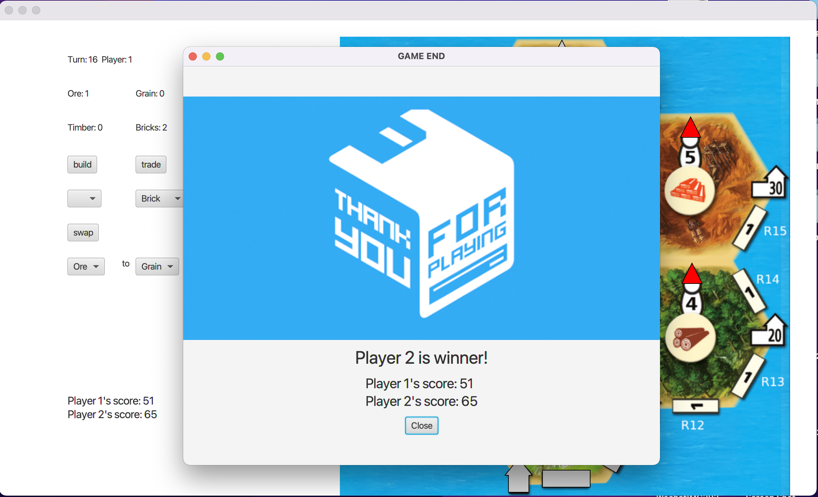
Step 4: End the Game
After 15 turn, game will be ended automatically and return winner based on players’ scores.

Slide 7
Question 1: The problem we looked at
1. How to implement all functions in one window, including the reality of the map, actions different players such as rolling dices building constructions, trading resources and exchanging resources?
Solution: Since rolling the dice and other behaviors are independent of each other, I designed the GUI to switch to mode and automatically switch to the build interface after rolling the dice.
2. When selecting buildings to build and resources to swap, there may be too many options that don‘t work.
Solution: Implement a method return only feasible options based on current board and resource state.

Slide 8
Question 2: Describe our design approach
We use Player class to represent player and Construction class to represent construction. We also have a Board class. When new a Board intance, we need to provide a Player instance because one player can only have one board. Board instance has a ArrayList field called constructions to contain all the constructions in this board. For different players, we need different Player instances and also relevent Board Instances.
In Game.java, we a array Players[player1, player2] to contain different players and another array Boards[board1, board2] to contain boards. We use a Player instance to represent current player called player(Player player). When number of players is decided, two arrays will be initialized.
Turn: 1
Players[] Boards[]
Player1 → board1
Player2 → board2
….. ……
player ->
<-board

Slide 9
Question 3: Interesting aspects of our game.
1. This game can be played with multiple players. Up to five players
2. Game itself is very interesting

